Slide 1
TYPES OF COMMUNICATION

Slide 2


ON THE BASIS OF EXPRESSION /METHOD
Verbal communication
Non- verbal communication

Slide 3
VERBAL COMMUNICATION
The word verbal means ‘word’.
Communication through spoken and written words is called verbal communication.
In the other words when the message is transmitted by a sender to a receiver with the help of written or spoken words.
Verbal communication can be devided into two types.

Slide 4
i - ORAL COMMUNICATION
When the communication is done by spoken words it is called oral communication.
In this kind of communication, the exchange of ideas, opinions and emotions is done through face to face or by some mechanical devices.
It takes place in different ways such as speech, conference, tele communication, seminars, interviews etc.

Slide 5
ii - WRITTEN COMMUNICATION
When the communication is done by written or printed words it is called written communication.
It takes place in different ways such as letter, report, e-mail, notice, magazine, newspaper, book etc.

Slide 6
NON- VERBAL COMMUNICATION
Any communication without the use of words is known as non-verbal communication.
By using non-verbal form of communication, a person can express his feeling to others quickly and economically.
Non-verbal communication includes all unspoken and unwritten messages, intentional or unintentional.

Slide 7
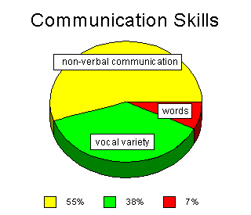
WORDS : 7%
HOW YOU SPEAK : 38%
BODY LANGUAGE : 55%

Slide 8
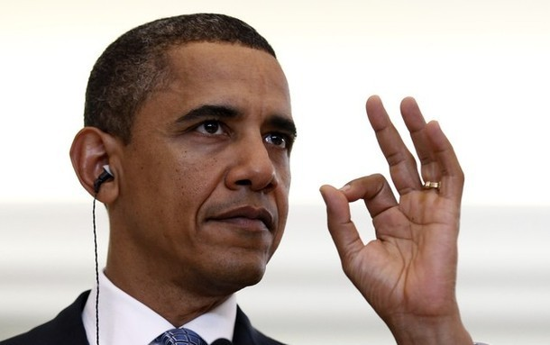
BODY MOVEMENT AND POSTURE KINESICS
Scientific study of ‘how the body speaks’ has been labeled as ‘KINESICS’.
Consider how your perceptions of people are affected by the way they sit, walk, stand, or hold their head. The way you move and carry yourself communicates a wealth of information to the world. This type of nonverbal communication includes your posture, bearing, stance, and the subtle movements you make.

Slide 9
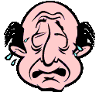

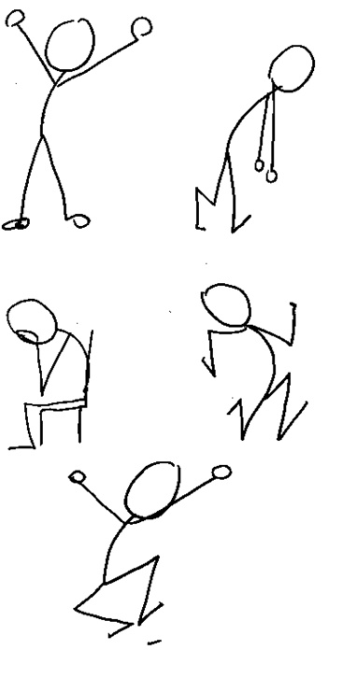
FORMS OF NON-VERBAL COMMUNICATION
Facial expression
Gestures
Eye contact
Body movement

Slide 10
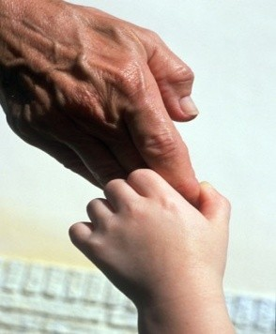

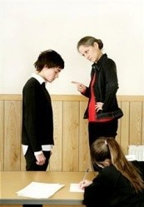
FORMS OF NON-VERBAL COMMUNICATION
Touch
Space
Paralanguage

Slide 11
FACIAL EXPRESSION
The human face is extremely expressive, able to convey countless emotions without saying a word. And unlike some forms of nonverbal communication, facial expressions are universal. The facial expressions for happiness, sadness, anger, surprise, fear, and disgust are the same across cultures.

Slide 12
GESTURES
Gestures are woven into the fabric of our daily lives. You may wave, point or use your hands when arguing or speaking animatedly, often expressing yourself with gestures without thinking.
However, the meaning of some gestures can be very different across cultures. While the OK sign made with the hand, for example, conveys a positive message in English-speaking countries, it’s consider offensive in countries such as Germany, Russia, and Brazil. So, it’s important to be careful of how you use gestures to avoid misinterpretation.

Slide 13
EYE CONTACT
Since the visual sense is dominant for most people, eye contact is an especially important type of nonverbal communication. The way you look at someone can communicate many things, including interest, affection, hostility, or attraction. Eye contact is also important in maintaining the flow of conversation and for gauging the other person’s interest and response.

Slide 14
SPACE(PROXEMICS)
Have you ever felt uncomfortable during a conversation because the other person was standing too close and invading your space?
We all have a need for physical space, although that need differs depending on the culture, the situation, and the closeness of the relationship.
You can use physical space to communicate many different nonverbal messages, including signals of intimacy and affection, aggression or dominance.

Slide 15
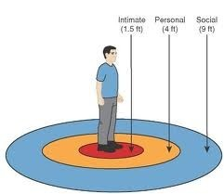
SPACE AND DISTANCE (Proxemics)
Understanding each
person’s border is
an important part of communication.
It is a part of Proxemics.

Slide 16
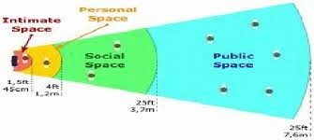
Space
■ There are different forms of space for different times, place & situations.
Intimate, Personal, Social and Public distances make up the concept of space.
■

Slide 17

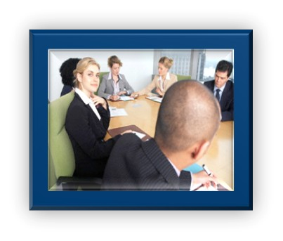
Intimate Distance:
actual touching to 6 to 18 inches.
Personal Distance: 18 inches to 4 feet.
Social Distance:
4 to 12 feet

Slide 18
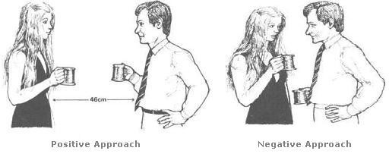
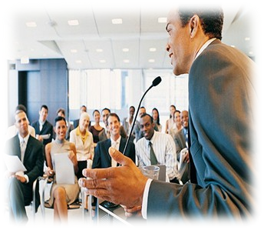
Space & Distance
Conversational Distance :
Public Distance :
12 to 25 feet

Slide 19
PARALANGUAGE(VOICE)
“It’s not just what you say, it’s how you say it”. When you speak, other people “read” your voice in addition to listening to your words.
Things they pay attention to include your timing and pace, how loud you speak, your tone and inflection, and sounds that convey understanding. Think about how your tone of voice can indicate sarcasm, anger, affection, or confidence.

Slide 20
PARALANGUAGE
Paralanguage is almost similar to verbal communication.
Language deals with ‘what is said’
Paralanguage deals with ’how it is said’
It is a type of non-verbal communication which includes – articulation, pronunciation, volume, pitch, rate and other vocal qualities.

